Slide 1
HDL Part II
陳培殷
國立成功大學 資訊工程系

Slide 2
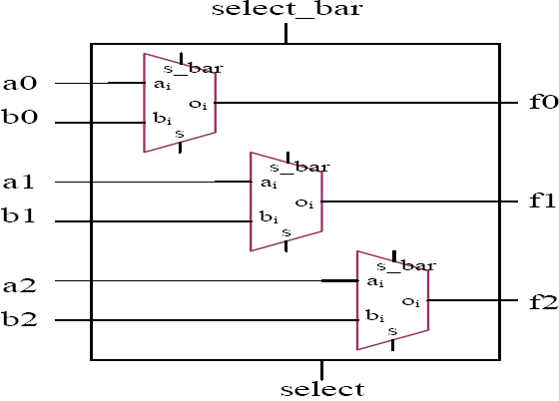
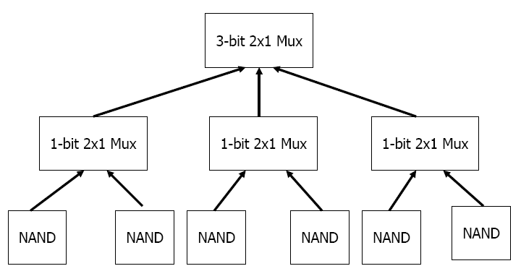
Design hierarchy

Slide 3
Instance Name
A module instance must have a name.
ex: OR_AND_STRUCTURAL
Note: naming skill is very important in Verilog
The use of an instance name with a primitive is optional.
ex: u1, u2
or u1(TEMP[0], IN[0], IN[1]);
or u2(TEMP[1], IN[2], IN[3]);
and (OUT, TEMP[0], TEMP[1]);

Slide 4
Port Mapping
In Order
Mux Mux_1(Sel,x,y,Mux_Out);
Register8 Register8_1(Clock,Reset,Mux_Out,Reg_Out);
By Name
Mux Mux_1(.Sel(Sel),.x(x),.y(y),.out(Mux_Out));
Register8 Register8_1(.Clock(Clock), .Reset(Reset) ,.data(Mux_Out)
,.q(Reg_Out));

Slide 5
Port Mapping by Position Association
module parent_mod;
wire [3:0] g;
child_mod G1(g[3], g[1], g[0], g[2]);
endmodule
module child_mod(sig_a, sig_b, sig_c, sig_d);
input sig_c, sig_d;
output sig_a, sig_b;
module description
endmodule
in-order port mapping

Slide 6
Port Mapping by Name Association
Name mapping is better, why ?
module parent_mod;
wire [3:0] g;
child_mod G1(.sig_c(g[3]), .sig_d(g[2]), .sig_b(g[0]),
.sig_a(g[1]));
endmodule
module child_mod(sig_a, sig_b, sig_c, sig_d);
input sig_c, sig_d;
output sig_a, sig_b;
module description
endmodule

Slide 7
Numbers (1/2)
Numbers are integer or real constants.
Integer constants are written as
<size>’<base format><number>
Real number can be represented in decimal or scientific format.
A number may be sized or unsized

Slide 8
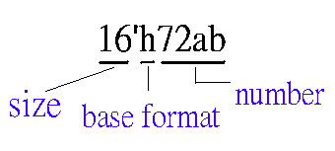
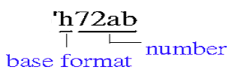
Numbers (2/2)
The base format indicates the type of number
Decimal (d or D)
Hex (h or H)
Octal (o or O)
Binary (b or B)
ex: unsize
size

Slide 9
Structural Description
Verilog allows three kinds of descriptions for circuits:
Structural description (2) Data flow description (3) Behavioral description
Structural description:
module OR_AND_STRUCTURAL(IN,OUT);
input [3:0] IN;
output OUT;
wire [1:0] TEMP;
or u1(TEMP[0], IN[0], IN[1]);
or u2(TEMP[1], IN[2], IN[3]);
and (OUT, TEMP[0], TEMP[1]);
endmodule
u1
TEMP[0]
u2
TEMP[1]
Synthesized (synthesis) +
optimized by tools

Slide 10
Data Flow Description
Data flow description
module OR_AND_DATA_FLOW(IN, OUT);
input [3:0] IN;
output OUT;
assign OUT = (IN[0] | IN[1]) & (IN[2] | IN[3]);
endmodule
Synthesized and
optimized by tools
NOTE:
What is the difference between C and Verilog ?
C : only one iteration (once) is implemented for assignment
Verilog : hard-wired circuit for assignment

Slide 11
Behavioral (RTL) Description (1/2)
Behavioral description #1
module OR_AND_BEHAVIORAL(IN, OUT);
input [3:0] IN;
output OUT;
reg OUT;
always @(IN)
begin
OUT = (IN[0] | IN[1]) & (IN[2] | IN[3]);
end
endmodule
Activate OUT while any voltage transition
(0 1 or 1 0) happens at signal IN

Slide 12
Behavioral (RTL) Description (2/2)
module or_and(IN, OUT);
input [3:0] IN; output OUT; reg OUT; (Note)
always @(IN)
begin
case(IN)
4'b0000: OUT = 0; 4'b0001: OUT = 0;
4'b0010: OUT = 0; 4'b0011: OUT = 0;
4'b0100: OUT = 0; 4'b0101: OUT = 1;
4'b0110: OUT = 1; 4'b0111: OUT = 1;
4'b1000: OUT = 0; 4'b1001: OUT = 1;
4'b1010: OUT = 1; 4'b1011: OUT = 1;
4'b1100: OUT = 0; 4'b1101: OUT = 1;
4'b1110: OUT = 1; default: OUT = 1;
endcase
end
endmodule
Truth Table
IN[0] | IN[1] | IN[2] | IN[3] | OUT
0 0 0 0 0 0 0 0 1 1 1 1 1 1 1 1 | 0 0 0 0 1 1 1 1 0 0 0 0 1 1 1 1 | 0 0 1 1 0 0 1 1 0 0 1 1 0 0 1 1 | 0 1 0 1 0 1 0 1 0 1 0 1 0 1 0 1 | 0 0 0 0 0 1 1 1 0 1 1 1 0 1 1 1
Behavioral description #2
Synthesized and
optimized by tools

Slide 13
Simulation
Response
Generation
Stimulus
and
Control
Verilog
Module
Verification
Waveform,
text reports
Waveform,
test patterns

Slide 14
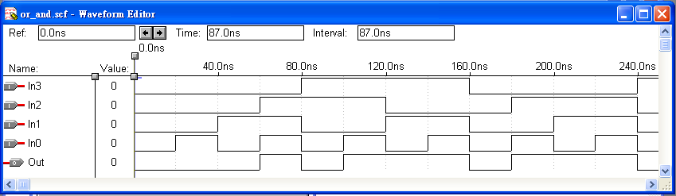
Waveform Simulation (1/2)
The results by using Altera functional simulation.
Most EDA tools support waveform simulation.
module OR_AND_DATA_FLOW(in, out);
input [3:0] in;
output out;
assign out = (in[0] | in[1]) & (in[2] | in[3]);
endmodule

Slide 15
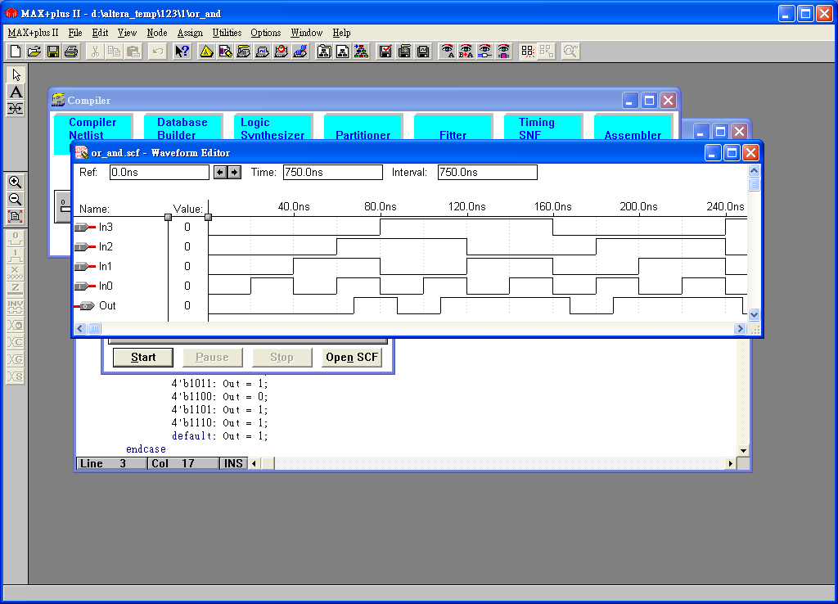
Waveform Simulation (2/2)
The results by using Altera functional simulation + timing simulation
delay (based on Altera Cell)
No delay is introduced if only functional simulation is used

Slide 16
Half Adder (1/2)

Slide 17
Half Adder (2/2)
Structural description
module Add_half(sum, c_out, a, b);
input a, b;
output sum, c_out;
wire c_out_bar;
xor (sum, a, b);
nand (c_out_bar, a, b);
not (c_out, c_out_bar);
endmodule
and (e, a, b,c,d);
a
b
c
d
e

Slide 18
Full Adder (1/2)

Slide 19
Full Adder (2/2)
(a⊕b) ⊕ c_in
c_in
a sum
Add_half
b c_out
sum
(a⊕b) c_in
w1
w3
a
a sum
Add_half
b c_out
c_out
(a⊕b)
M2
b
(a⊕b) c_in + ab
M1
ab
w2
module Add_full(sum, c_out, a, b, c_in);
input a, b, c_in;
output sum, c_out;
wire w1, w2, w3;
Add_half M1(w1, w2, a, b);
Add_half M2(sum, w3, c_in, w1);
or (c_out, w2, w3);
endmodule
module Add_half(sum, c_out, a, b);
input a, b;
output sum, c_out;
assign {c_out, sum} = a + b;
endmodule

